Slide 1
Microsoft's Movie Studio
Macharia, Ian
12 March,2023

Slide 2
Background
Microsoft is a Tech company that is responsible for creating the Windows operating system
They want to enter the movie industry and they want to know what types of films have been successful at the box office.
They have asked us to use exploratory data analysis to generate insights for their new movie studio. The goal of this project is to analyze the data from six different sources and provide Microsoft's head of the movie studio with actionable insights.

Slide 3
Data Exploration
Because the data was collected from various locations, the different files have different formats.
Some are compressed CSV (comma-separated values) or TSV (tab-separated values) files that can be opened using spreadsheet software or pd.read_csv, while the data from IMDB is located in a SQLite database.

Slide 4
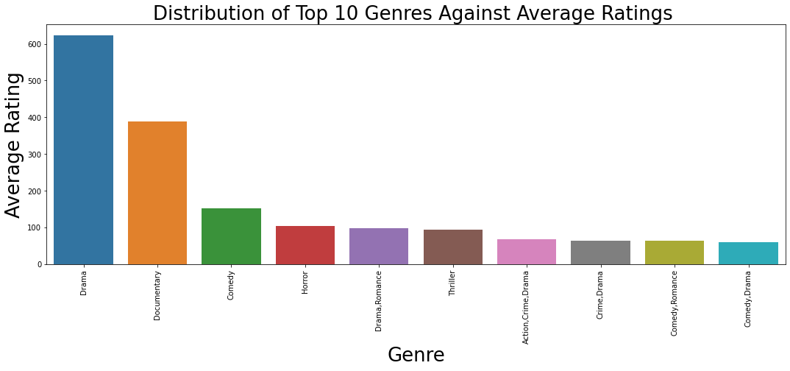
Distribution of Genres by Ratings
We observe the highest earning genre is Drama, followed by Documentary ,Comedy, Horror, Drama/romance, Thriller .

Slide 5
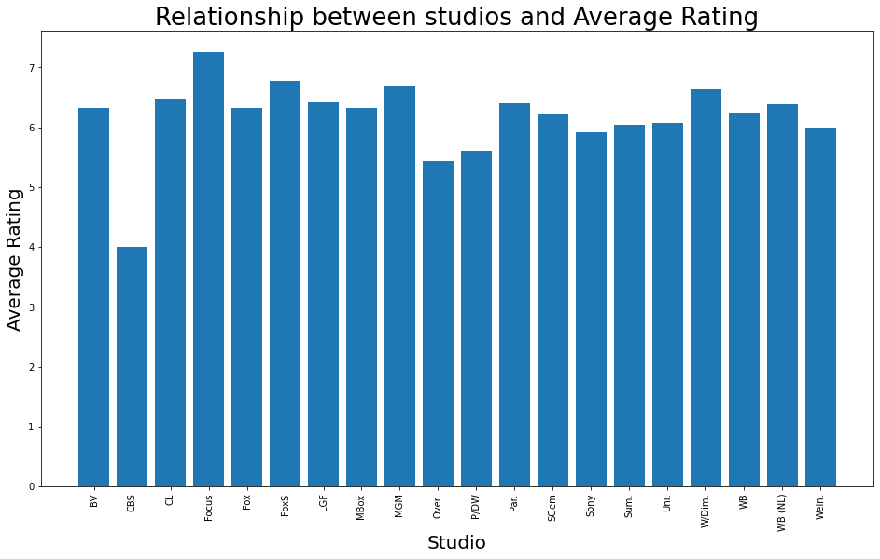
Relationship between studios and Average Rating
We observe that the highest rated studio is Focus studio, while the Highest earning studio was WB even the second rated Fox studios did not also garner good ratings.

Slide 6
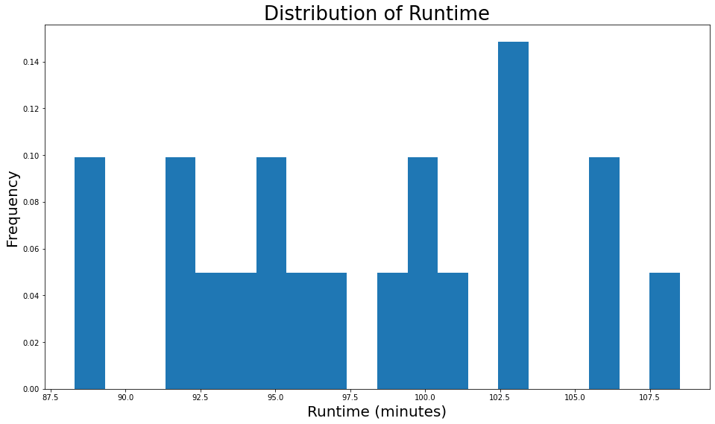
Distribution of Runtime
We Might also need to consider which movies had the most ratings based on their duration.

Slide 7
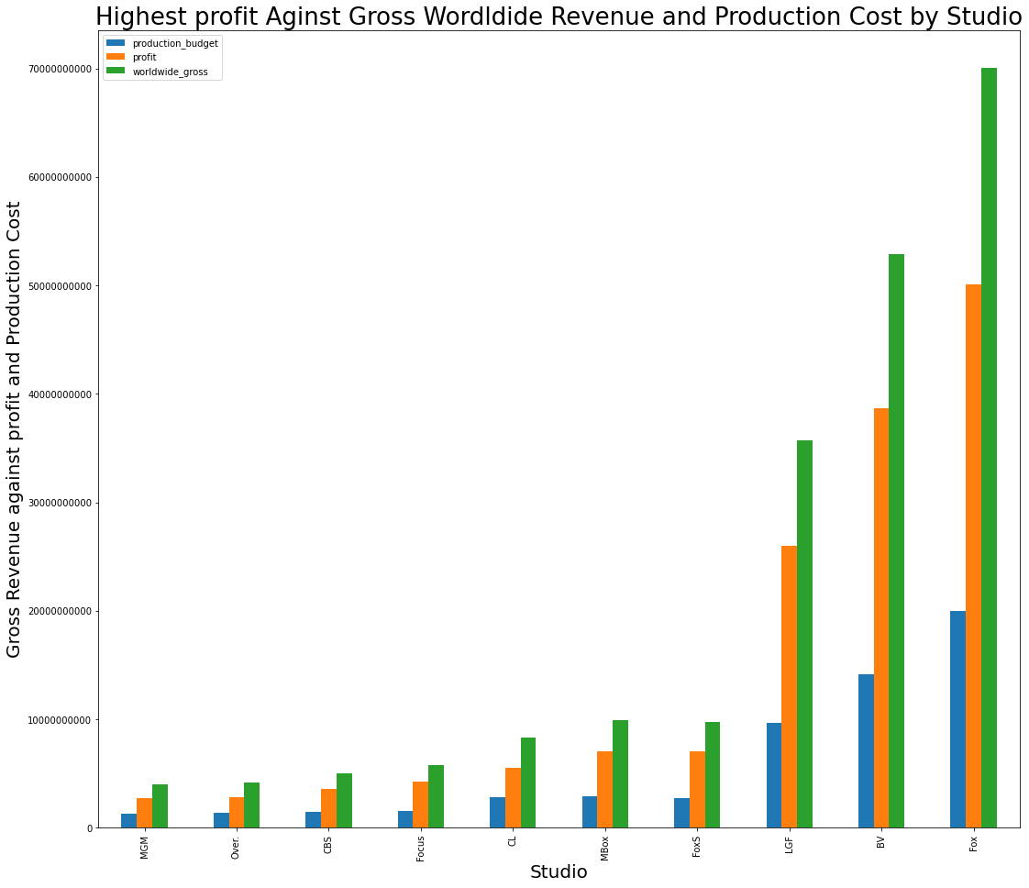
Earnings vs Expenses of the leading Studios
This is aplot showing the earnings and expenses of the leading studios, where Warner Bros is the highest earning production studio, which can be attributed to the higher number of movies they release.
Notes:
We also observe that having a higher budget does not neccesarily mean that the earning will be the same as in the case between Fox and WB, where fox spent more that WB but this did not reflect on the sales.

Slide 8
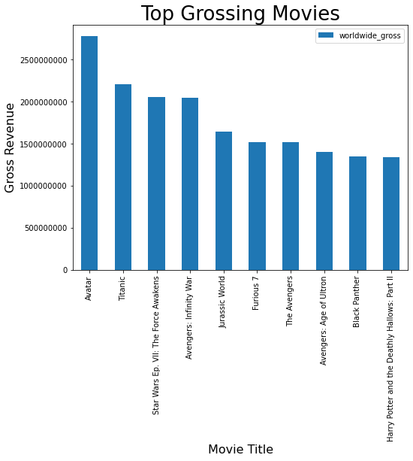
Top Grossing Movies
We observe that the highest grossing movies are from the genre Sci-Fi, with more than seven out of the ten coming form that genre and above 5 from the studio but it is not among the ones that are highly rated. but from our knowledge we know they do not have many productions, but the few they have make them sufficient profits.

Slide 9
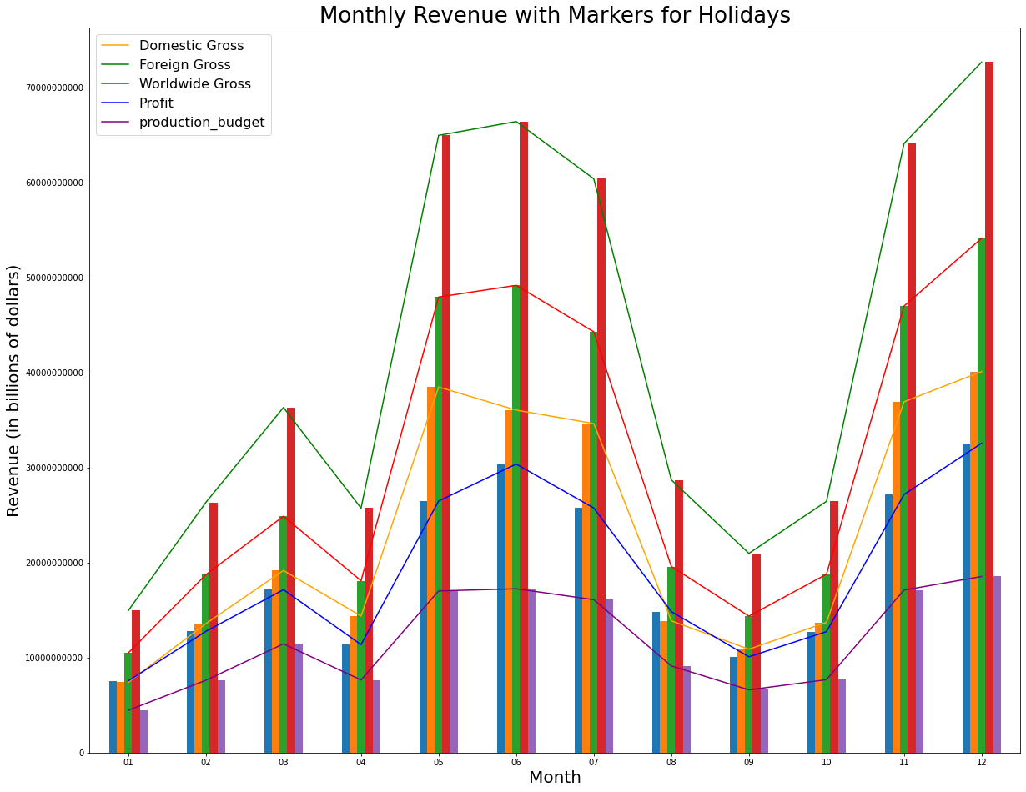
Monthly Revenue with Markers for Holidays
Notes:
From the graph above we can observe that the peach time for releasing movies was during the holiday season.
Specifically during the summer months of `May, June, July` and the winter months of `November and December`.
We observe that for foreign gross represents a higher contribution to the worldwide revenue, which is logically true
if all countries in the world have submited revenue, but we know this is not an actual representation of the data since the foreign gross had the highest number of missing values in the dataset.

Slide 10
Recommendations
In this project, we analyzed data from five different sources to generate insights for Microsoft's new movie studio. We presented three concrete business recommendations based on our analysis:
Microsoft should focus on producing Drama, Documentary, and comedy movies.
Microsoft should consider partnering with Warner Bros. and Focus studio for its new movie studio.
Microsoft should consider releasing movies during the holidays.
Microsoft can use these recommendations to help them decide what types of films to create.

Slide 11
Thank You

